Slide 1
Project Context & Business Problem
Outbound Funnel Intelligence: Uncoordinated Multi-Touch Outreach Analysis
Overlap & Attribution Risk
Business Problem Statement
Where the Problem Occurs
Outbound sales teams frequently engage the same prospect across multiple campaigns, senders, and touchpoints. While this increases outreach coverage, it also creates sender overlap, ownership conflicts, CRM duplication challenges, and unreliable funnel attribution.
Lead
Multiple Senders
Overlap & Attribution Risk
Distorted Funnel Metrics
Project Objective
Develop a journey-level analytical framework to measure funnel performance, quantify sender overlap, assess CRM data quality, and identify opportunities to improve outreach efficiency and reporting reliability.
Uncoordinated multi-touch outreach creates visibility, ownership, and reporting challenges across the sales funnel.
18,014 Total Journeys
718 Converted Journeys
72.5% Sender Overlap Rate

Slide 2
Analytical Approach
Data Sources
SQL Modeling
KPI Framework
(Email + Campaign Reporting Grain)
Dataset
Structured in 8 Sequential SQL Stages
Dataset | Grain | Purpose
Email Activity | 1 outreach | Outreach History
Engagement | 1 engagement | Responses & Outcomes
Contacts | 1 CRM | Identity Data
Campaigns | 1 campaign | Campaign Strategy
Senders | 1 sender | Ownership & Segmentation
Environment Setup
Data Validation
Relationship Validation
Summary Layers
Sender Overlap Model
Analytical Master
Journey Validation
KPI Development
Funnel Performance
Reply • Qualified • Converted
Sender Coordination
Overlap • Conversion Delta
Outreach Efficiency
Touchpoints • Duration
5 operational datasets representing the complete outbound prospect journey.
CRM Data Quality
Duplicates • Identity Resolution

Slide 3
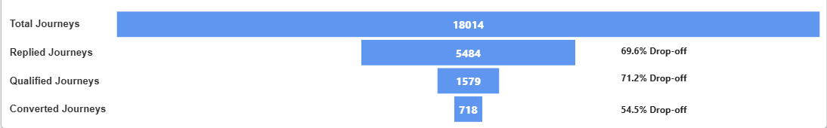
Funnel Performance Findings
18,014 Total Journeys
5,484 Replied Journeys
1,579 Qualified Journeys
718 Converted Journeys
Journey Conversion Funnel
Primary Leakage
Qualification Quality
Key Finding
71.2% Reply → Qualification
Qualification quality, not outreach volume, is the strongest predictor of conversion.
45.5% Qualified → Converted

Slide 4
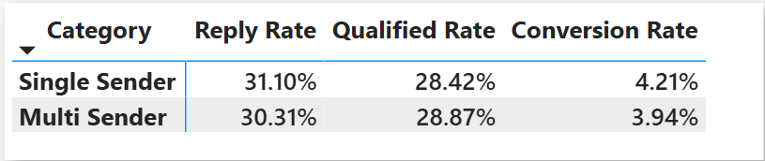
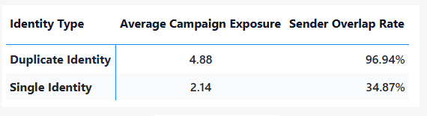
Sender Overlap & CRM Duplication
72.5% Sender Overlap Rate
0.27 pp Conversion Delta
47.4% CRM Duplication Rate
Performance Comparison Matrix
CRM Duplication Impact
Identity Exposure Comparison
Executive Interpretation
• 72.5% sender overlap exists, yet conversion differs by only 0.27 percentage points. • CRM duplication is the root cause of fragmented ownership and multi-sender exposure. • Overlap is primarily an operational coordination issue rather than a measurable conversion performance issue.

Slide 5
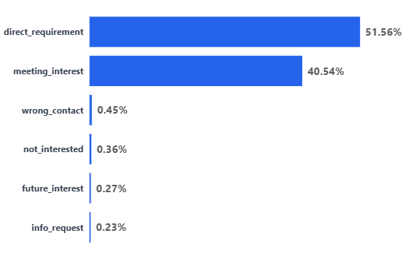
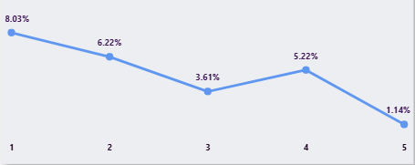
Response Quality & Outreach Efficiency
Response Quality
Outreach Efficiency
Key Business Insight
• Direct Requirement (51.6%) and Meeting Interest (40.5%) are the strongest predictors of downstream conversion. • Conversion performance is strongest at the first touchpoint (8.0%) and declines significantly after the third contact. • Response quality and early buying intent are stronger predictors of conversion than outreach frequency.

Slide 6
Business Recommendations
01
02
03
ACTION
ACTION
ACTION
Implement Email-Level Sender Assignment Rules
Standardize CRM Identity Management & Deduplication
Optimize Outreach Sequence Length & Touchpoint Strategy
RATIONALE
RATIONALE
RATIONALE
72.5% of prospect journeys experienced multi-sender outreach, while conversion performance differed by only 0.27 percentage points between single-sender and multi-sender journeys.
47.4% CRM duplication rate and 96.9% sender overlap among duplicate identities indicate fragmented prospect ownership and inaccurate exposure tracking.
Conversion declined from 8.0% at Touchpoint 1 to 1.1% at Touchpoint 5, while the highest journey volume was concentrated in later-stage outreach.
SUCCESS METRIC
SUCCESS METRIC
SUCCESS METRIC
Outreach Efficiency (Conversion Rate per Touchpoint Stage)
Sender Overlap Rate Baseline: 72.5%
Direction: Decrease
CRM Duplication Rate Baseline: 47.4%
Direction: Decrease
EXPECTED IMPACT
EXPECTED IMPACT
EXPECTED IMPACT
Reduce duplicate outreach, improve ownership clarity, and strengthen attribution integrity.
Improve contact accuracy, reduce duplicate records, and establish a trusted prospect view.
Reduce outreach effort, improve seller productivity, and focus activity on high-probability leads.
Outbound Funnel Intelligence | SQL • Power BI • Data Modeling | 18,014 Journeys Analyzed

